Slide 1
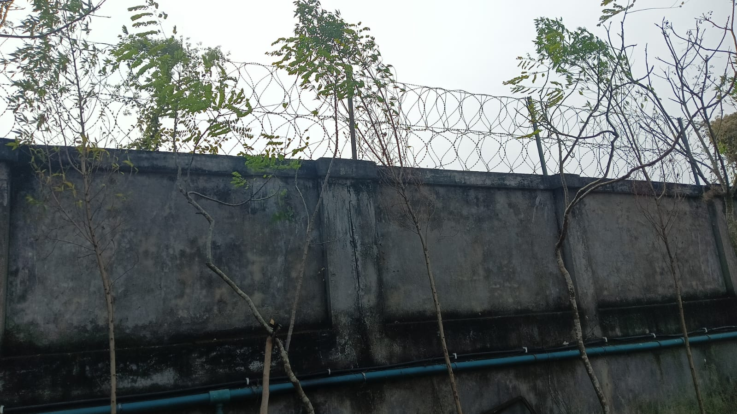
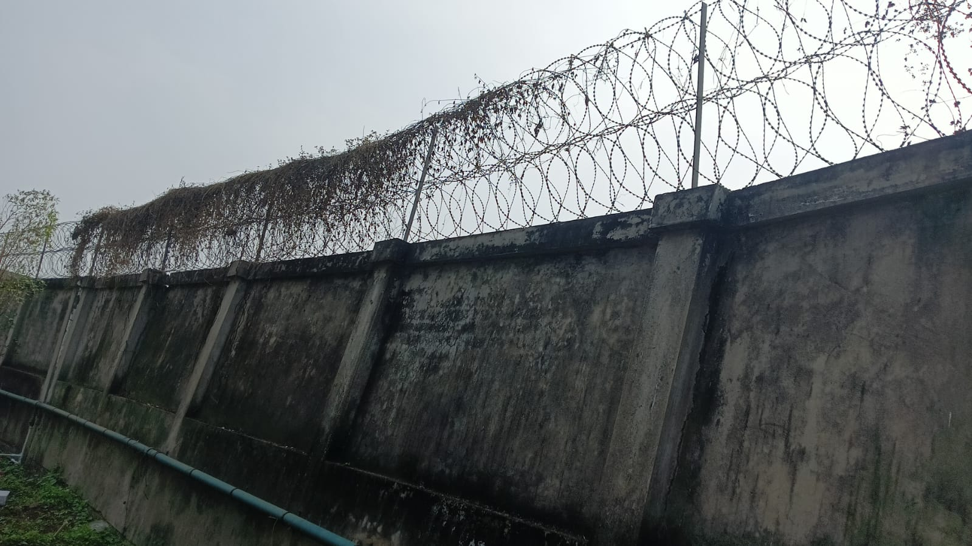
BOUNDARY WALL:
Work in progress

Slide 2
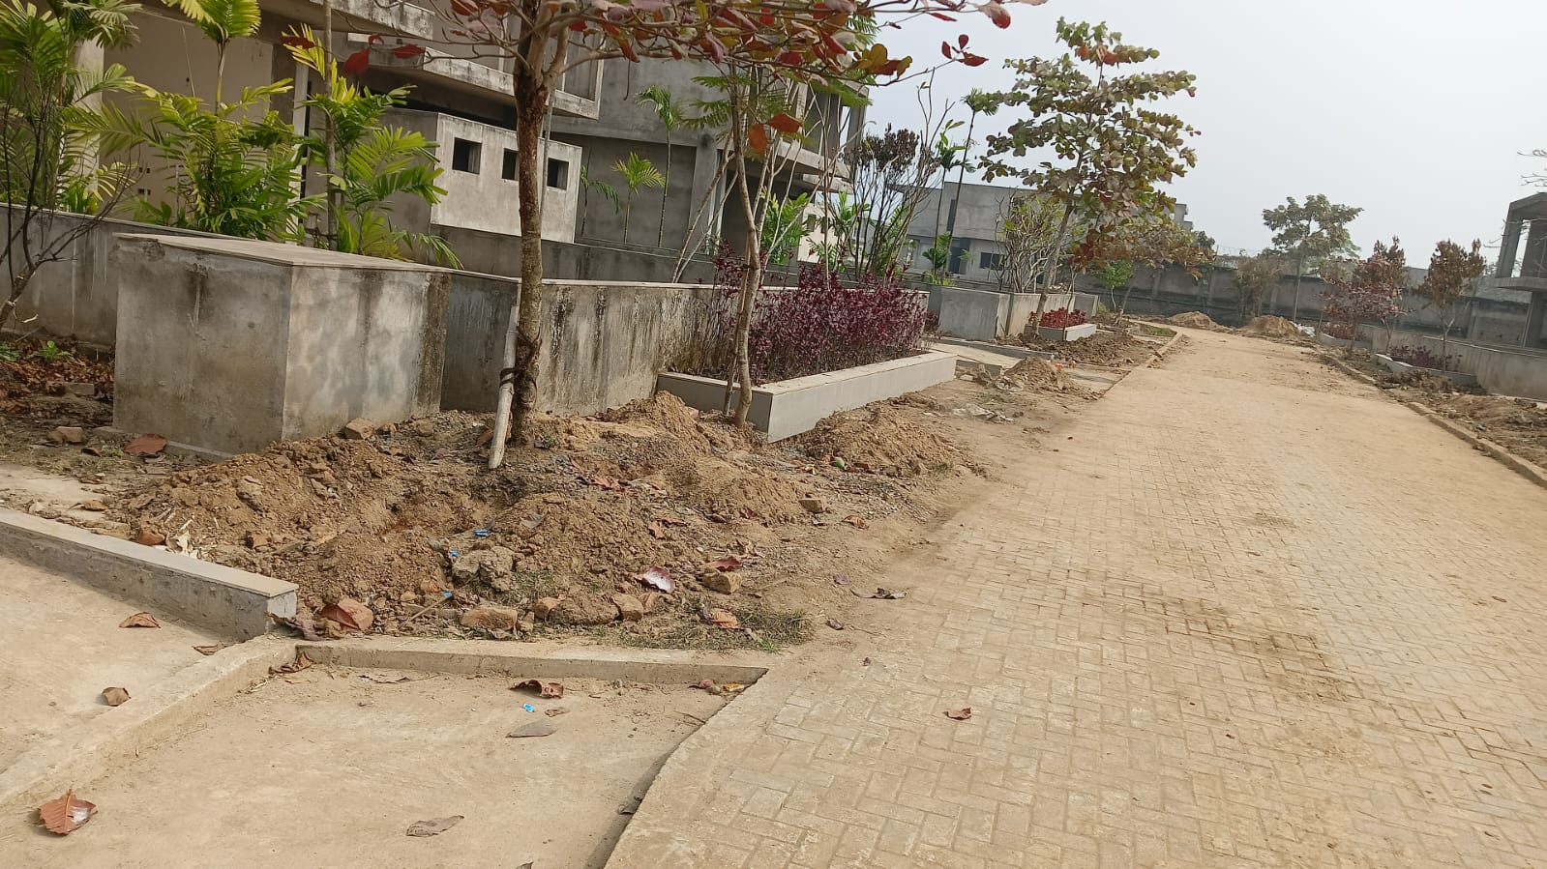
DRIVEWAY :
Work in progress

